Slide 1
Language Movement and Bengali Nationalism
Dr. Saleh Shahriar
North South University
Bashundhara,
Dhaka-1229, Bangladesh
Email: saleh.shahriar@northsouth.edu ORCID: https://orcid.org/0000-0001-5199-3258

Slide 2
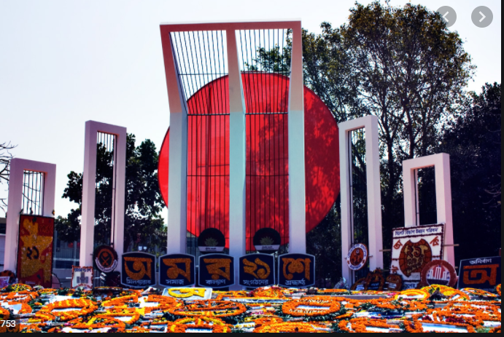

Slide 3



Slide 4
Bengal fell at the hands of Emperor Akbar in 1576, hence Persian becoming the official language of the province. It continued as the language of the Bengali intelligentsia and officials till 1838.
Under the Mughal rulers, Urdu, composed of letters and words mainly from Hindi, Persian, and Arabic, emerged as an Army language. For ensuring unity and uniformity in the army, Urdu evolved as a common language of command in Akbar's army. With the formation of Muslim League in Dhaka in 1906 and the Lucknow Pact in 1916, Urdu revived again its former influence.

Slide 5
The Problems & Issues

Slide 6
As a legacy of the colonial rule, English was used after independence in the civil-military establishments and educational institutions. Besides English, the government used Urdu in running the state of affairs in newborn Pakistan.
The special treatment of Urdu and negligence to Bengali aroused discontent, especially among the Bengali intelligentsia, political leaders and students. Moreover, economic and regional disparities became widened during the days of United Pakistan. Say, for instance, the educational disparities between the two wings.
Please have a look at the selected indicators shown in two Tables in the next two slides.

Slide 7
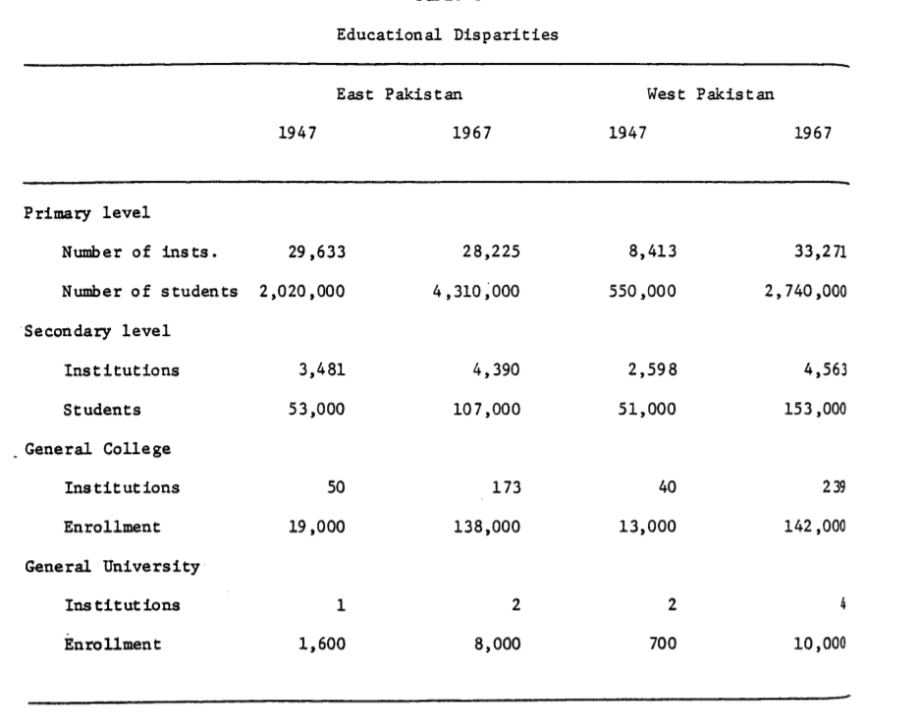

Slide 8
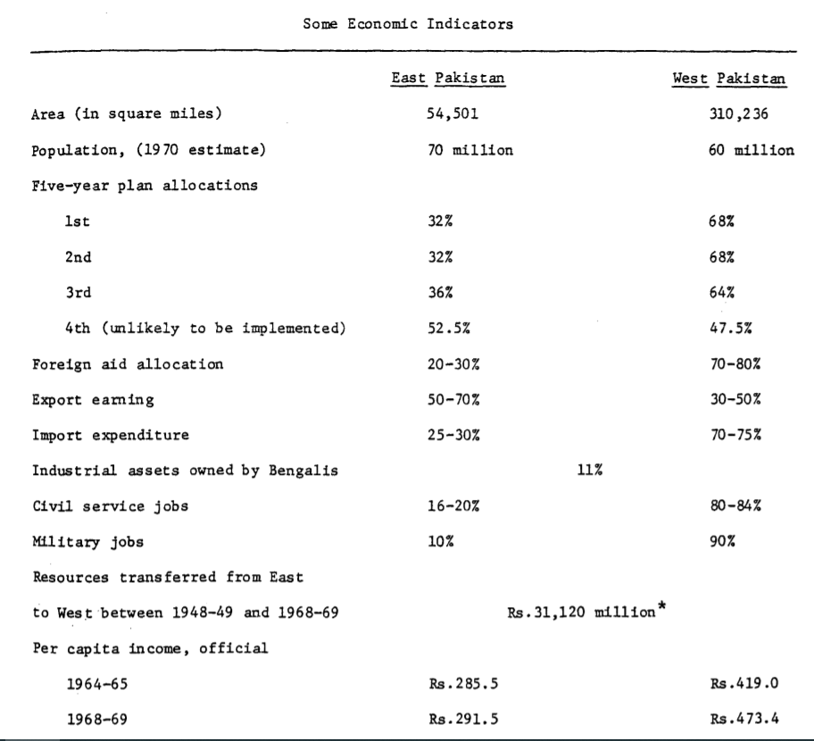

Slide 9
Aligarh University in UP was at the center of this debate in the beginning. In July 1947, the former VC of the university Dr. Ziauddin advocated in favour of Urdu as the state language of Pakistan. Instantly Dr. Muhammad Shahidullah, Professor of Bengali at Dhaka University, in a July 19 article in the Daily Azad: "The Language Problem of Pakistan" wrote that Bengali should become the medium of instruction as well as official language in East Pakistan. The demand took a formal shape with the formation of the Gana Azadi League in Dhaka during the same month.

Slide 10
Dr. Muhammad Shahidullah played an important role in the language movement.
He was the first to establish the reasons why Bangla, instead of Urdu, should be the state language of Pakistan. Earlier, he was Secretary to the Bengal Muslim Literary Society (1911) and had presided over many meetings and conventions, including the second Bengal Muslim Literary Convention (1917), Muslim Literary Society Convention in Dhaka (1926), All-Bengal Muslim Youth Convention in Calcutta (1928), All-India Oriental Studies Convention (Philology, 1941) and East Pakistan Literary Convention (1948)

Slide 11

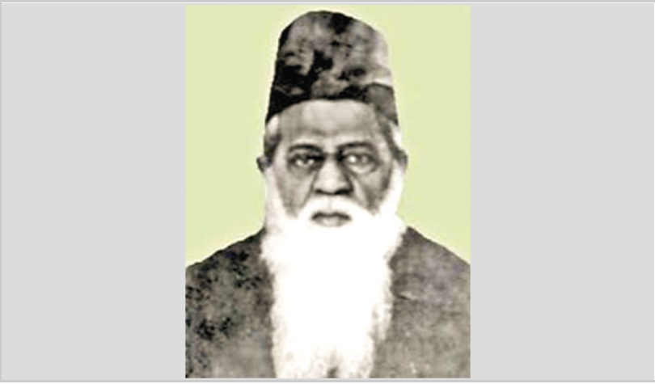

Slide 12
Immediately after the birth of Pakistan in August 1947, the controversy over language issue topped the list of priorities in the country as Bengali was spoken by 56.3 percent, while about 7.3 percent people spoke Urdu. The government maintained that being the language of none of the five provinces of Pakistan, Urdu would present equal advantage and disadvantage to all those who would be competing for central services.

Slide 13
On February 25, 1948, Dhirandra Nath Dutta, a member of the Pakistan Constituent Assembly from Congress background, strongly spoke in favour of Bengali language. He argued:
"Out of sixty-nine million people in Pakistan, forty four million people speak Bengali … the state language should be the language which is used by the majority of the people of the state, and for that, I consider Bengali language is a lingua franca of our state”.
Opposing his argument, Prime Minister Liaquat Ali Khan maintained that: "Pakistan has been created because of the demand of a hundred million Muslims in the subcontinent and the language of the hundred million Muslims is Urdu … Pakistan is a Muslim state and it must have as its lingua franca, the language of the Muslim nation."

Slide 14
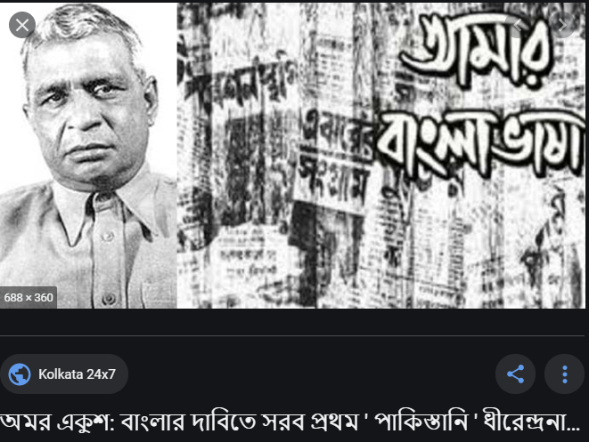

Slide 15
Tamaddun Majlish, the group which took initiative to demand that Bengali should be the state language of Pakistan along with Urdu, led by physicist Abul Kashem emerged as one the powerful groups on behalf of the Bengali language. Their demand gradually gained popularity among the Dhaka University students. Students under the banner of the Tamaddun Majlish insisted the provincial Prime Minister Khwaja Nazimuddin adopt a resolution through the Assembly and send it to the central government recommending Bengali as one of the state languages of Pakistan. Fearing troubles from the students, just before Jinnah's arrival in East Pakistan, Nazimuddin signed an agreement with the students in line with their demands on language issue.

Slide 16
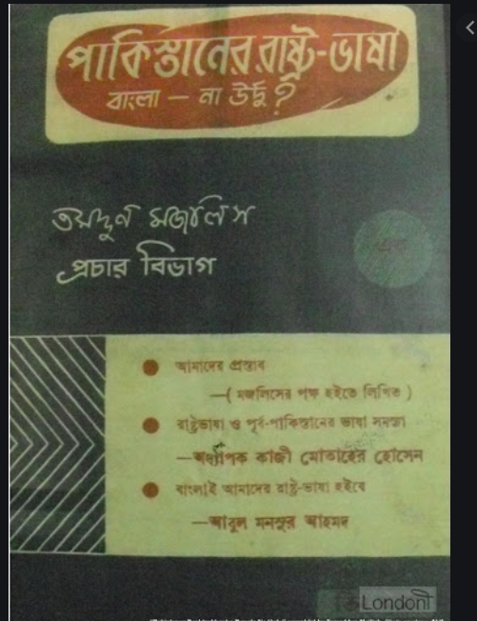

Slide 17
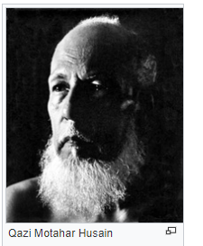
The first organized opposition to Urdu, however, came from the Tamuddin Majlis, a cultural organization formed by professors and students at Dhaka University in September 1947. In a booklet entitled "Pakistaner Rashtra Bhasha, Bangla na Urdue”, it was proposed that (1) the Bengali Language shall be the following: a) the medium of instruction in East Pakistan, b) the medium of court communication, c) the medium of mass communication; and that (2) "The languages of the central government will be both Urdu and Bengali."
One contributor in the booklet, professor Kazi Mothar Hussain, argued that the attempt to impose Urdu as the national language stands for the possibility of replacing old masters with new ones from the same religion. He maintained that the attempt to impose Urdu against the will of the people of East Bengal would result in total failure. He even warned that "it might lead to the end of the relationship between the East and the West’’.

Slide 18
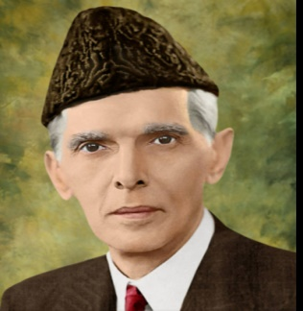
Nonetheless, being tempted by the statement of Dhirandra Nath Dutta, the then Governor General of Pakistan, Mohammad Ali Jinnah, on March 11, 1948 declared in unequivocal terms at Suhrawardy Uddan that "only Urdu would be the state language of Pakistan."
Jinnah repeated his statement at the Dhaka University Convocation in Curzon Hall on March 24. The declaration aroused mass discontent, the students of Dhaka University being in the forefront.
After the death of Liaquat Ali Khan in 1951, Khwaja Nazimuddin became the Prime Minister of Pakistan and opted in favor of Urdu, which was his first language. On January 26, 1952, he declared in Paltan Maidan that Urdu "shall be the only state language of Pakistan." The Dhaka students reacted because of his retreat from his earlier promise in 1948.

Slide 19
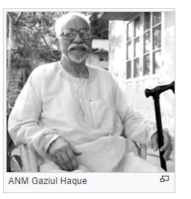
On January 30, Maulana Bhashani conducted a meeting of the socio-political groups: East Pakistan Awami Muslim League, Khelafat-e-Rabbani, Tamuddun-e-Majlish, State Language Movement Parishad, etc. at the Muktar Library to oppose Prime Minister Nazimuddin. On February 4, Dhaka University State Language Movement Parishad brought out a procession under the leadership of Gaziul Haq to protest Nazimuddin. On February 21, a protest move took the form of putting pressure on the provincial Assembly, then in session in the Jagannath Hall, to pass a resolution in support of Bengali as a state language. When the students moved towards the Assembly defying government orders, police opened fire and the February tragedy was underway.

Slide 20
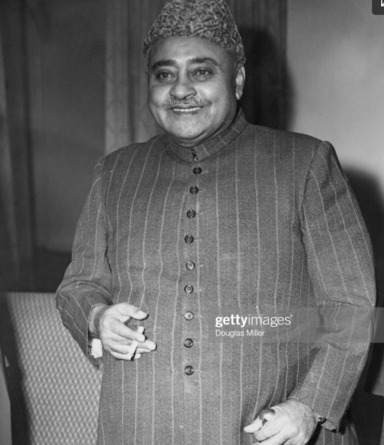
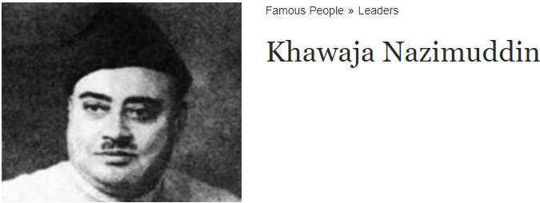
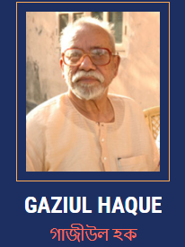

Slide 21
It was quite logical to press a demand for the recognition of Bangla as one of the state languages because the majority people in Pakistan spoke it. Educated Bengali people, or at least a large part of them, although seeming to favour Urdu at the initial stage, gradually raised their voice for a number of reasons.
As a result of the long colonial heritage, the Bengali intelligentsia, political leaders and students were concerned about the economic welfare and well being of the eastern region. They perceived that the non-recognition of the Bengali language was nothing but a new design of colonial exploitation. They also perceived that with Urdu and English as state languages, the mass people in East Pakistan would be in a disadvantageous situation especially in getting jobs and economic activities. A barrier in the communication process would lead the Bengali nationals towards economic deprivation and backwardness.

Slide 22
With the establishment of Dhaka University in 1921, a trend of the new development was marked among the Bengali middle class people. They became aware of the language issue particularly in terms of their social and class interest. They were suspicious about the political activities of the Urdu speaking zamindars and nobility who regarded Bengali as the "language of the lower caste Hindus" and claimed Urdu as the "language of the nobility." Among these groups of people who favored Urdu, Khwaja Nazimuddin and Akram Khan were prominent in Eastern Bengal. They came from conservative upper class background. In 1952, the declaration of Urdu as state language by Khwaja Nazimuddin, the Prime Minister of Pakistan, sparked mass discontent in East Pakistan.

Slide 23
The main driving force of the 1952 movement was the students, working in close cooperation with political party members. The students took the crucial step of breaking section 144 on February 21, and in so doing they courted arrest and some of them died.
The language movement drew widespread sympathy and support from the rural areas, in part because the large majority of Bengali students came from these areas ( Rounaq Jahan, Pakistan: Failure in National Integration, page 44)
Poet Mahbubul Alam Chowdury and his poem on the language martyers

Slide 24
Implications & Achievements :
From the beginning Pakistani rulers were concerned about the geographical separation of the country by hostile India and perceived the dominance of Bengali language in East Bengal as the number one barrier towards achieving political integration. Because of their hypersensitivity they failed to reach a logical solution of the language debate and resorted to force instead. Although the central government in 1956 incorporated Bangla as one of the state languages of Pakistan the decision came too late and couldn't address the fear and mistrust that had already been planted in the minds of the Bengali people.

Slide 25


Slide 26
Since 1952, February 21 has been observed every year to commemorate the martyrs of the Language Movement. This movement was the seed out of which grew up the tree of Bengali nationalism that helped create Bangladesh in 1971. With UNESCO adopting a resolution on November 17, 1999 proclaiming February 21 as "International Mother Language Day" the Language Movement of Bangladesh has come to be honored and recognized by the international community.

Slide 27
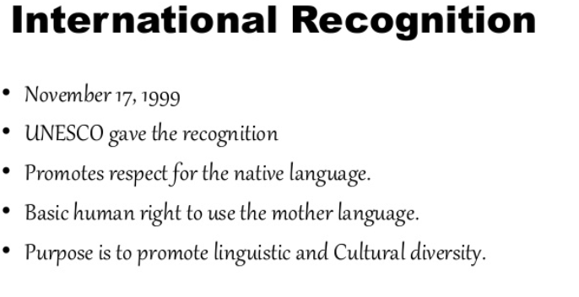

Slide 28
Conclusions :
Twenty One Point Programme objectives incorporated in the election manifesto of the united front, an alliance of the opposition political parties, to contest elections of the East Bengal Legislative Assembly in 1954 against the then party in power, Muslim league

Slide 29
Ever since its creation in 1947, Pakistan has been a geographical absurdity, with its two parts separated by one thousand miles of unfriendly Indian territory. Greater than the spatial distance was the difference in the social structure, economy and culture. Adherance to a common religion, Islam, was never sufficient to make these two dissimilar parts a single nation. But for almost twenty-four years Pakistan weathered all storms and maintained a precarious unity. That unity was finally broken in March 1971 when the West Pakistani military launched an all-out war to suppress the movement for regional autonomy in East Pakistan, forcing the region to declare itself an independent People's Republic of Bangladesh
Growth of Bengali linguistic nationalism
Regional identity politics
Emergence of Bangladesh as a nation-state

Slide 30
References :
Badruddin Omar, The Emergence of Bangladesh-The Rise of Bengali Nationalism ,1958-1971 ( Oxford : Oxford University Press, 2006).
Rounaq Jahan, Pakistan: Failure in National Integration (Dhaka: University Press Limited , 2018).
Abul Mansur Ahmed, আমার দেখা রাজনীতির পঞ্চাশ বছর (Fifty Years of Politics as I saw It). M.Emdadul Haq, “A Short History of Bangla”, The Daily Star
Shahriar, S. (2026). The politico-cultural roots of Bangladesh: remembering the language movement through memoirs and autobiographical narratives.
Cogent Arts & Humanities, 13(1). https://doi.org/10.1080/23311983.2026.2684824

